Slide 1
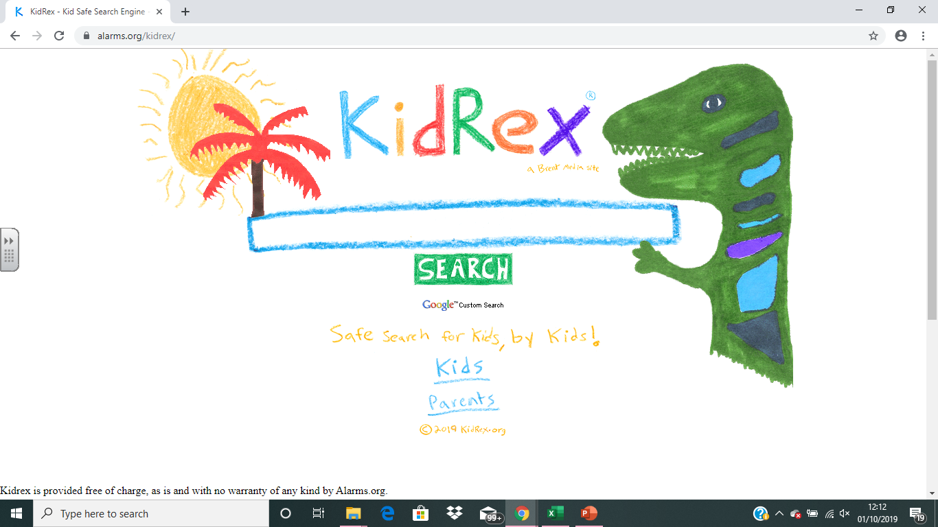


The back arrow lets you go to the previous page
TIP:
If you move or delete something, just press CTRL + Z to undo the mistake.
This is the scroll bar
The left button minimises.
The middle button maximizes.
The right button closes.
This is a tab
This opens a new tab
Google Chrome Microsoft Edge
Parts of a web browser

Slide 2
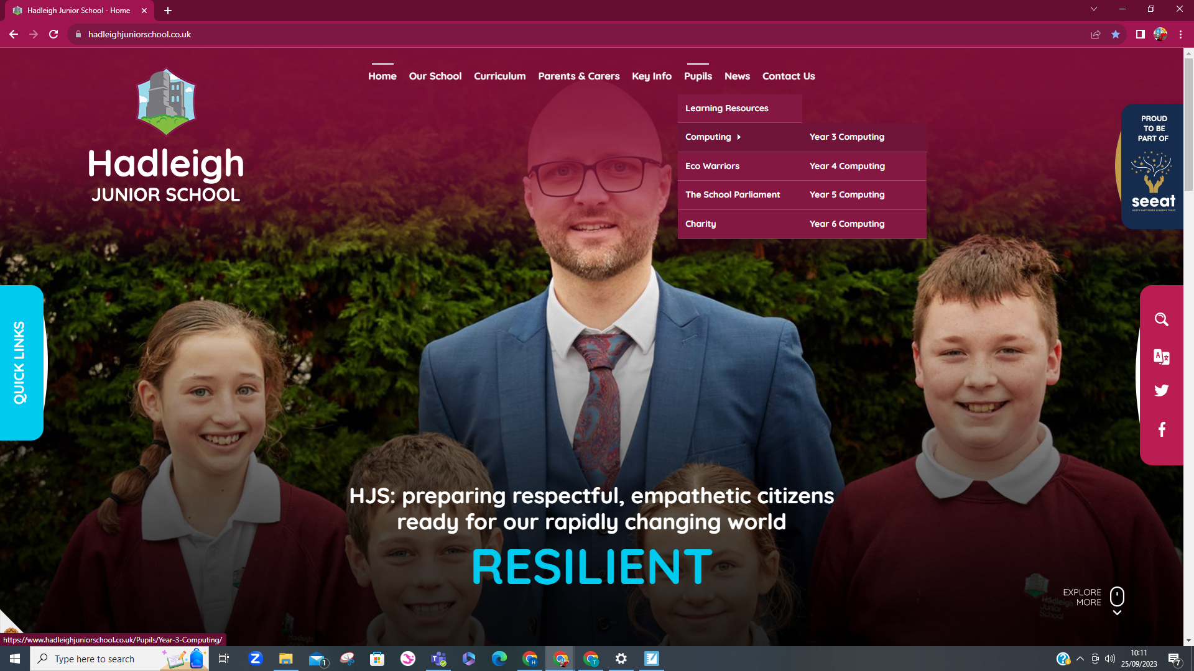
This is text
This is an image
This is the website address
This is the menu
The button changes colour to show you that it is clickable
Parts of a webpage

Slide 3
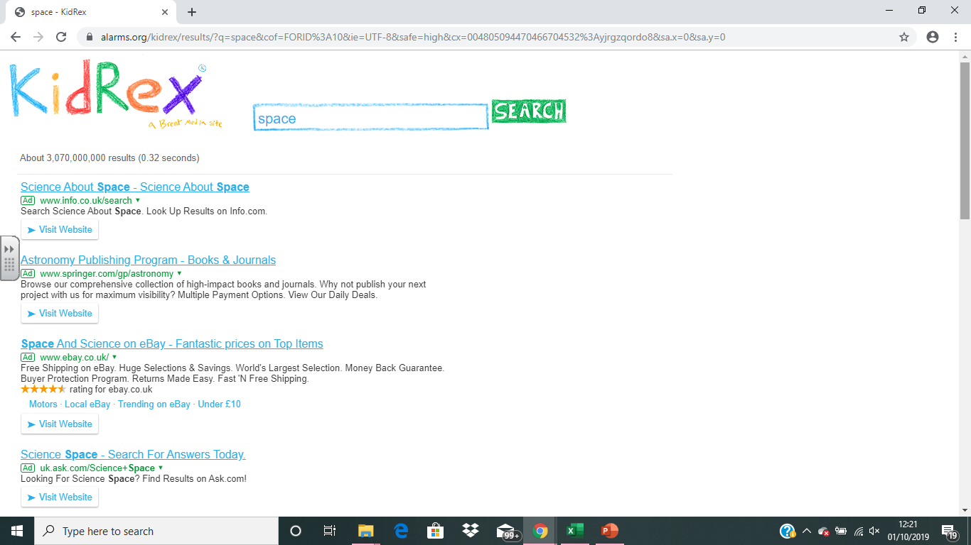
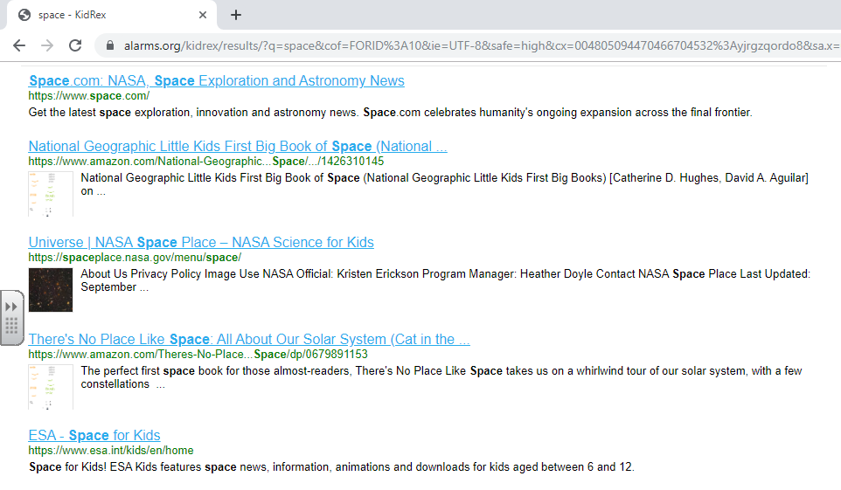
This is the search bar
This shows us how many results there were
Ad means adverts
Blue, underlined words are links
These do not say ad, so are the website I should look at
Parts of a search engine

Slide 4
You will now use a child-friendly search engine to locate information about the Stone Age:
www.swiggle.org.uk
https://www.alarms.org/kidrex/

