Slide 1
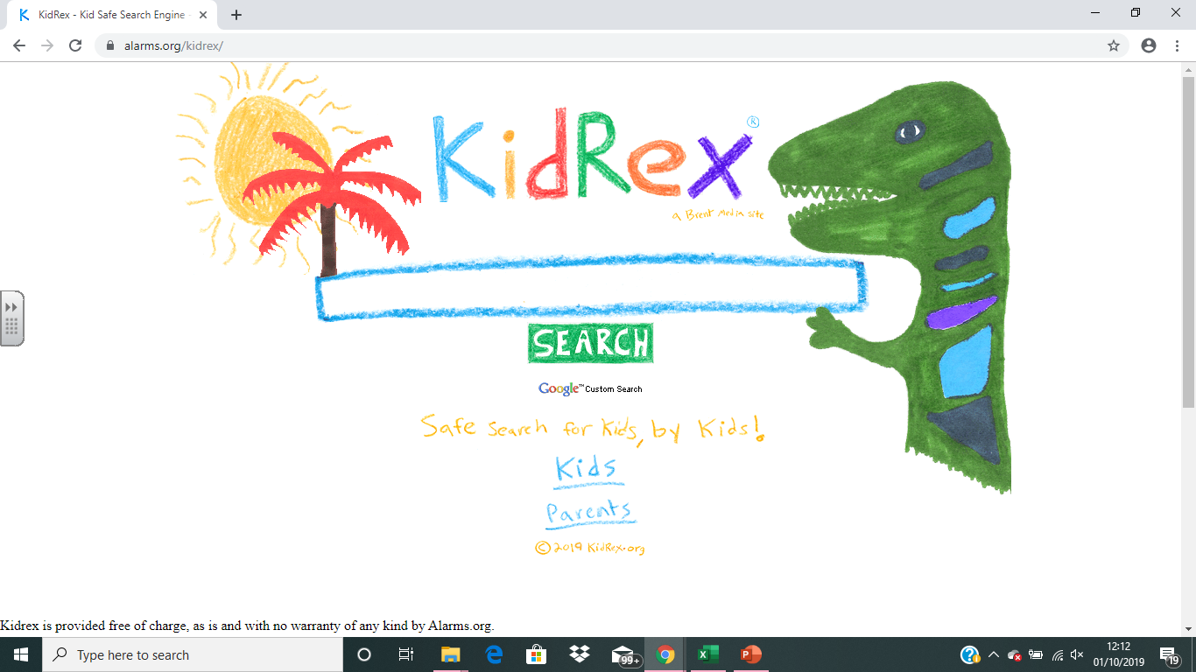


TIP:
If you move or delete something, just press CTRL + Z to undo the mistake.
Challenge 1.
What is this area called?
Answer: It is called a …
Challenge 2.
What happens when I press this?
Answer: It will open a new …
Challenge 1.
What do these arrows do?
Answer: They allow you to go…
Challenge 2.
What do these three icons do?
Answer:
The left button…
The middle button…
The right button…
Google Chrome Microsoft Edge
Challenge 1.
What will happen if I press this?
Answer: It will let you …
Parts of a web browser

Slide 2
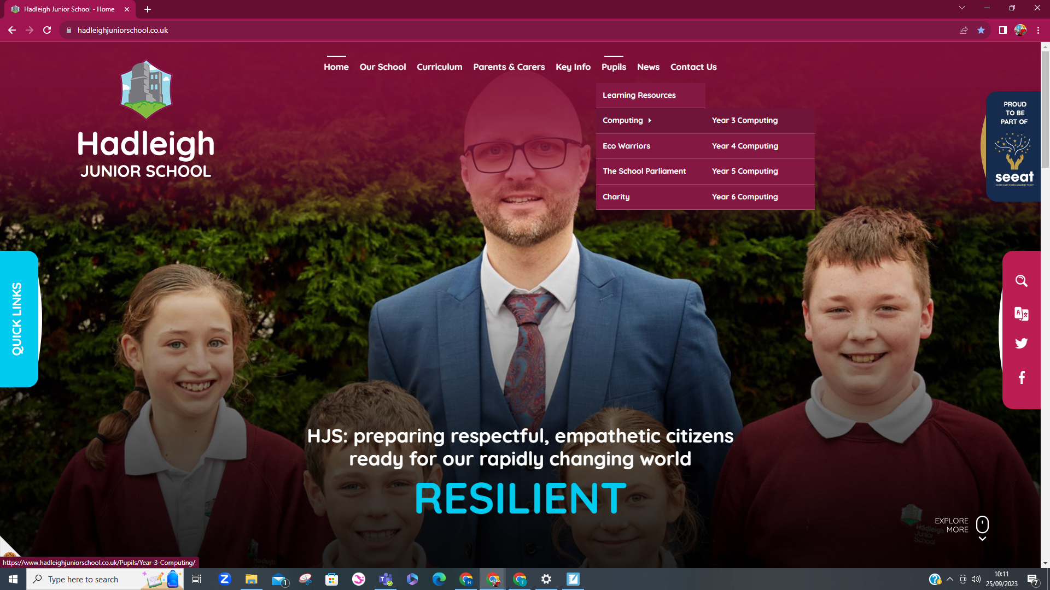
Challenge 1. What is this area of a webpage called?
Answer: It is the …
Challenge 1. What is this called on a webpage?
Answer: It is…
Challenge 2. Why does it change colour when your cursor (mouse pointer) is over it?
Answer: It changes colour to show you that …
Challenge 3. Explain this section of a webpage:
Answer: This is the website’s…
Parts of a webpage
Challenge 1. What is this called on a webpage?
Answer: It is an …

Slide 3
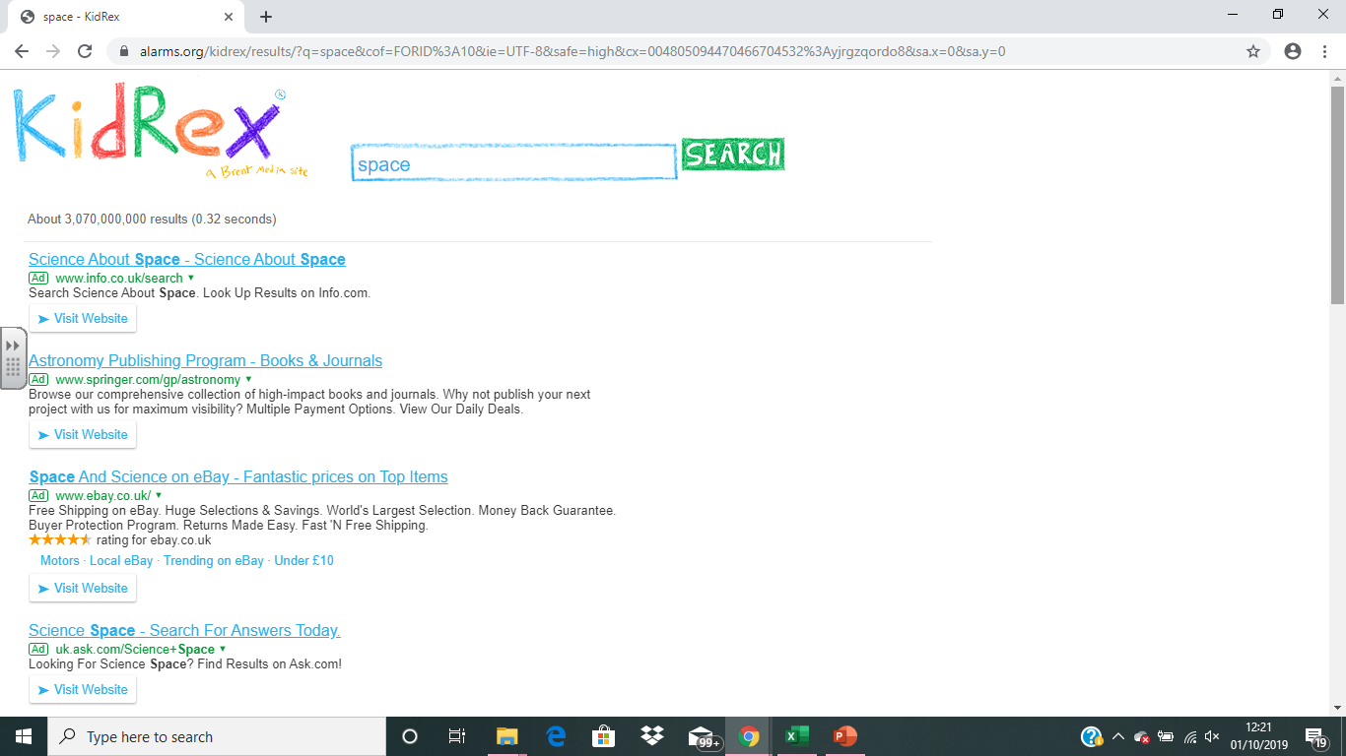
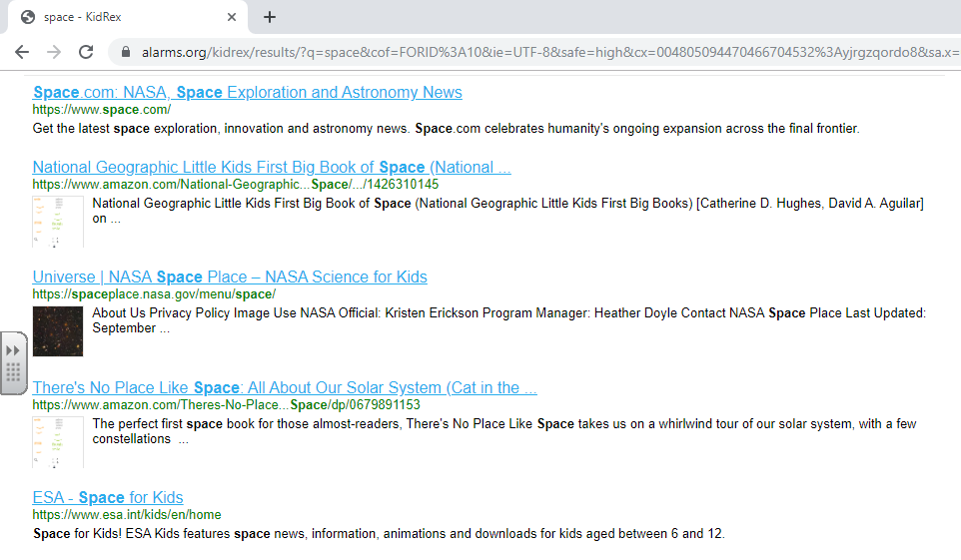
Challenge 1. What is this number showing us?
Answer: It is showing us how many…
Challenge 1. What is this section called?
Answer: This is the…
Challenge 3. I have now scrolled down and can see links without ‘Ad’ – what does this mean?
Answer: These websites are not …
Challenge 2. What do these blue underlined words mean?
Answer: These are…
Challenge 3. All of these say ‘Ad’. What does that mean?
Answer: These websites are …
Parts of a search engine

Slide 4
You will now use a child-friendly search engine to locate information about the Stone Age:
www.swiggle.org.uk
https://www.alarms.org/kidrex/

